Slide 1
Regular Expressions
Introduction to Regular Expressions | Special Characters | Character Ranges | Meta Characters | Mode Modifiers | Determining What Matches
Notes:
Welcome to our lecture on Regular Expressions. In this lecture we will go through introduction to regular expression, special characters, character ranges, meta characters, mode modifiers, and will se how to determine what matches in string pattern. Let’s start the video lecture.

Slide 2
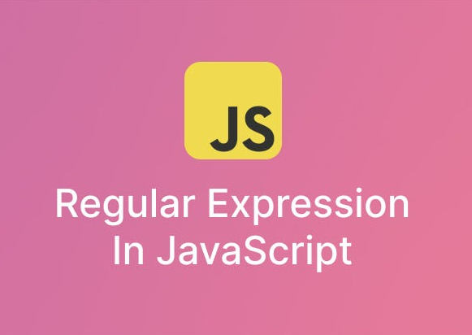
Introduction to Regular Expressions
Programs often need to check if a string follows a specific pattern.
Example: Validating phone numbers or searching DNA sequences.
Regular expressions (regex) help match and manipulate string patterns.
Notes:
Today we will discuss regular expressions, commonly known as regex. Many programs need to check if a string follows a specific pattern. For example, we use regex to validate phone numbers or search for specific DNA sequences. Regex is a powerful tool for matching and manipulating text. It is widely used in programming languages like JavaScript to streamline text processing tasks efficiently.

Slide 3
Introduction to Regular Expressions
Defined using the RegExp object or slashes: let re = /abc/;
"abc" matches any string containing "abc".
test(str) checks if a string matches the regex, returning true or false.
Notes:
Regular expressions in JavaScript are defined using the Reg Exp object or slashes. For example, let re equal slash ABC slash creates a regex pattern. This pattern matches any string containing ABC. The test function checks if a string matches the pattern, returning true or false. Regex is useful for searching text, validating input, and manipulating strings efficiently in programming.

Slide 4
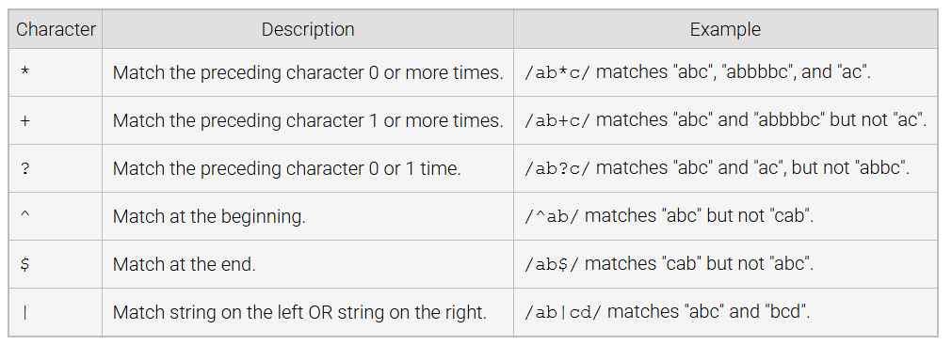
Special Characters
Notes:
Now we will look at special characters in regular expressions. The star matches the preceding character zero or more times. The plus matches one or more times. The question mark allows zero or one occurrence. The caret ensures a match at the beginning, while the dollar sign matches at the end. The vertical bar acts as an OR operator. Next, we will explore practical examples of using these special characters.

Slide 5
Character Ranges
Square brackets [ ] match any character within a specified range. Ex: /[aeiou]/ matches any vowel, /[0-9]/ matches any digit.
The caret ^ inside brackets negates the range. Ex: /[^str]/ matches any character except 's', 't', or 'r’.
Useful for defining flexible matching patterns in strings.
Notes:
Now let us discuss character ranges in regular expressions. Square brackets are used to match any character within a defined range. For example, using brackets with vowels matches any vowel, and using zero to nine matches any digit. The caret inside brackets negates the range, meaning it excludes certain characters. This is useful for defining flexible patterns in text matching. Next, we will see some examples in action.

Slide 6
Metacharacters
A metacharacter represents a class of characters in a regex pattern.
The period (.) matches any single character except a newline. Ex: /ab.c/ matches "abZc" or "ab2c" but not "abc".
Other metacharacters start with a backslash () and have special meanings.
Notes:
Metacharacters play an important role in regular expressions. They represent a class of characters within a pattern. One common metacharacter is the period, which matches any single character except a newline. For example, a pattern with a period can match different variations of a word. Other metacharacters begin with a backslash and have unique functions. Next, we will explore these in more detail.

Slide 7
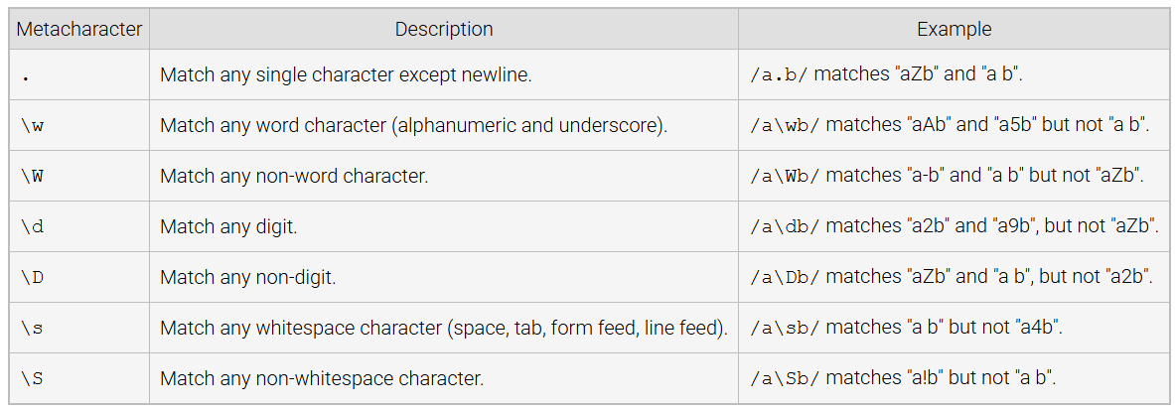
Selected Metacharacters
Notes:
Let us look at selected metacharacters in regular expressions. The period matches any character except a newline. The backslash w matches any word character, while backslash W matches non-word characters. Similarly, backslash d matches digits, and backslash D matches non-digits. Backslash s represents whitespace, whereas backslash S matches non-whitespace characters. Next, we will see these in practice.

Slide 8
Mode Modifiers
Mode modifiers (flags) change how a regex matches patterns.
Placed after the second slash in a regex. Ex: /abc*/i.
The i flag makes matching case-insensitive (e.g., "ABC" matches "abc").
Notes:
Mode modifiers or flags change how a regex pattern behaves. They are placed after the second slash in a regex. For example, the i flag makes the match case insensitive, meaning uppercase and lowercase letters are treated the same. This is useful when searching text without worrying about capitalization. Flags help refine search behavior. Next, we will explore other useful regex flags.

Slide 9
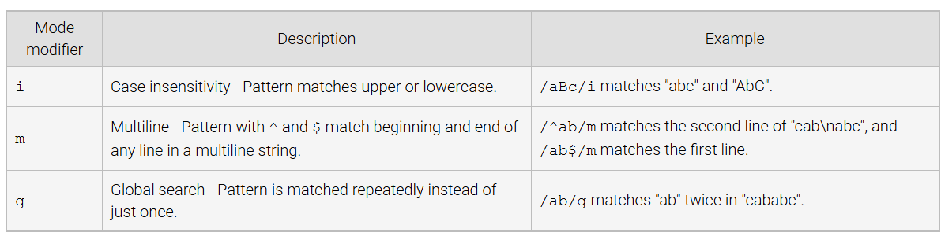
Selected Mode Modifiers
Notes:
Now let us look at selected mode modifiers in regular expressions. The i modifier makes the pattern case insensitive, so uppercase and lowercase letters are treated the same. The m modifier enables multiline matching, allowing caret and dollar symbols to work on each line. The g modifier allows global search, meaning the pattern is matched multiple times instead of just once. Next, we will see these in action.

Slide 10
Determining What Matches
exec(str) method finds and returns the matching part of a string as an array or null if no match is found.
Parentheses ( ) in a regex capture specific parts of a match for later use. Ex: /a(b+)c/ remembers "bbb" in "abbbc".
The result array contains the full match as the first element and captured groups as subsequent elements.
Notes:
To determine what matches in a regex pattern, we use the exec method. It searches a string and returns the match as an array or null if no match is found. Parentheses in a regex capture specific parts of the match for later use. For example, capturing groups help extract certain elements from a string. The result array stores the full match first, followed by captured groups. Next, we will see examples of this in use.

Slide 11
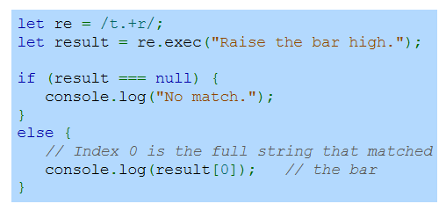
Example
Notes:
Here is an example using the exec method in JavaScript. The regex pattern searches for a letter t followed by one or more characters and ending with r. The exec function checks if the string contains a match. If no match is found, it prints no match. Otherwise, it logs the matched text. In this case, it finds the phrase the bar. This demonstrates how regex can extract specific patterns from text. Thanks for watching the lecture.

